Slide 1
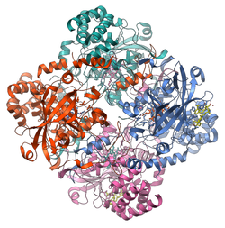
Catalase
Catalase
2H₂ O₂ → 2H₂O + O₂(g)

Slide 2
Three Experiments
Effect of pH
Effect of temperature
Effect of a possible inhibitor (Cu⁺²⁾

